Slide 1

Geometry
Unit 7, Lesson H3 Area of a Triangle Using the Sine Ratio Volume 1, pg. 439

Slide 2


Benchmark
MA.912.T.1.4
Solve mathematical problems involving finding the area of a triangle given two sides and the included angle.
volume 1, pg. 439

Slide 3
Integrated Mathematical Thinking and Reasoning Standards
MA.K12.MTR.1.1 Actively participate in effortful learning both individually and collectively.
MA.K12.MTR.2.1 Demonstrate understanding by representing problems in multiple ways.
MA.K12.MTR.4.1 Engage in discussions that reflect on the mathematical thinking of self and others.
MA.K12.MTR.5.1 Use patterns and structure to help understand and connect mathematical concepts.
volume 1, pg. 439

Slide 4

Learning Target
I can find the area of a triangle using the sine ratio.
volume 1, pg. 439

Slide 5

Warm-Up
volume 1, pg. 440

Slide 6
7.H3.1 Warm-Up: History of Mathematics
Hannah Fry is an English mathematician who works alongside physicists, mathematicians, computer scientists, architects, and geographers to study the patterns in human behavior. Fry’s research applies to a wide range of social problems and questions, from shopping and transport to urban crime, riots, and terrorism.
Fry has also written two popular math books: The Mathematics of Love: Patterns, Proofs, and the Search for the Ultimate Equation and The Indisputable Existence of Santa Claus.
volume 1, pg. 440

Slide 7
Fry is quoted as saying, “There is a mathematical angle to almost anything.”
Interpret this quote in your own words.
What is a specific real-world example where mathematics is present?
volume 1, pg. 440

Slide 8

Exploration
volume 1, pg. 440

Slide 9

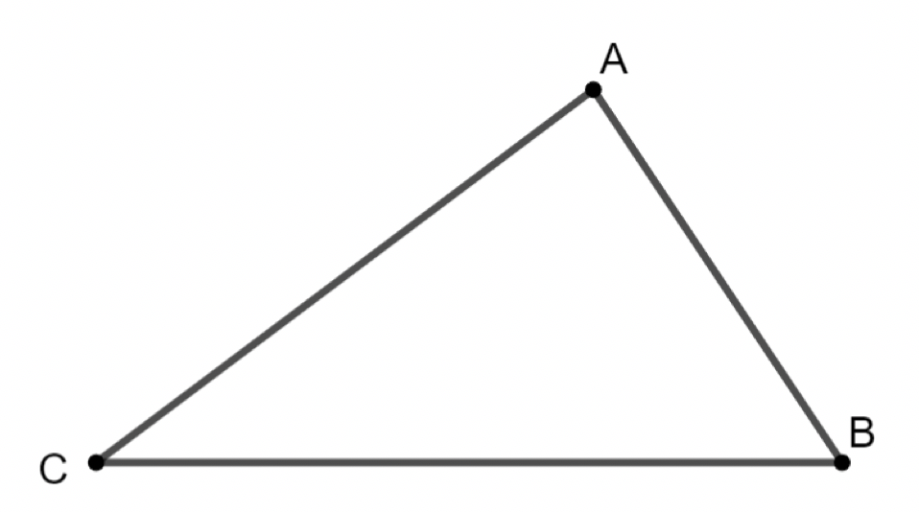

7.H3.2 Exploration: Area of a Triangle
$∆ABC$ is shown.
Use $∆ABC$ to do the following.
Draw an altitude from point $A$ to side $\overline{CB}$
Label the altitude as $h$.
Label the point where the altitude intersects side $\overline{BC}$ as $D$.
Label the sides as $AB=c, BC=a,$ and $AC=b$.
volume 1, pg. 440

Slide 10
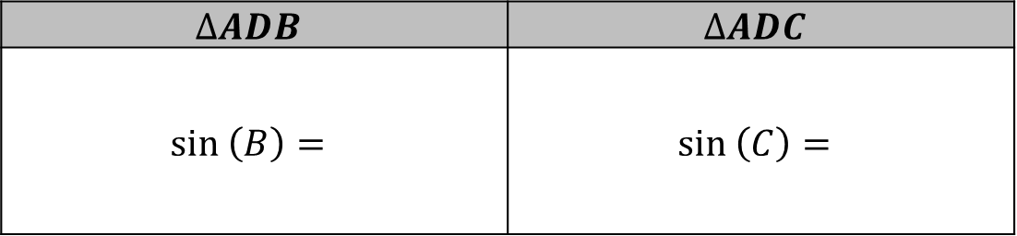
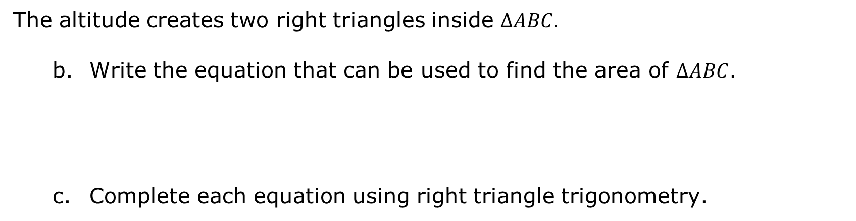
The altitude creates two right triangles inside $ΔABC.$
Write the equation that can be used to find the area of $ΔABC$.
Complete each equation using right triangle trigonometry.
$$∆ADB$$ | $$∆ADC$$
$$sin \left(B\right)=$$ | $$sin \left(C\right)=$$
volume 1, pg. 440

Slide 11
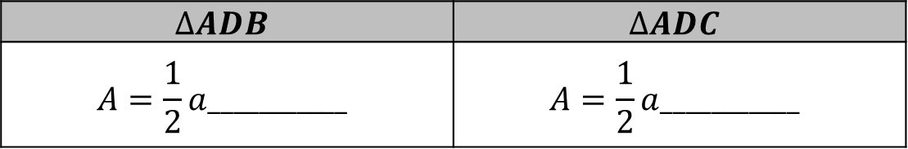
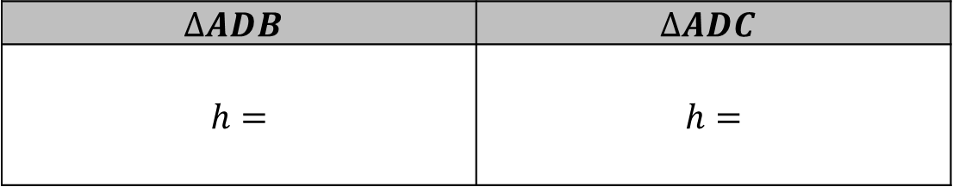

Rewrite each equation in terms of $h$.
Substitute each expression into the formula, $A=\frac{1}{2}ah$.
What do you notice about the two equations?
$$∆ADB$$ | $$∆ADC$$
$$h=$$ | $$h=$$
$$∆ADB$$ | $$∆ADC$$
$$A=\frac{1}{2}a___________$$ | $$A=\frac{1}{2}a___________$$
volume 1, pg. 441

Slide 12
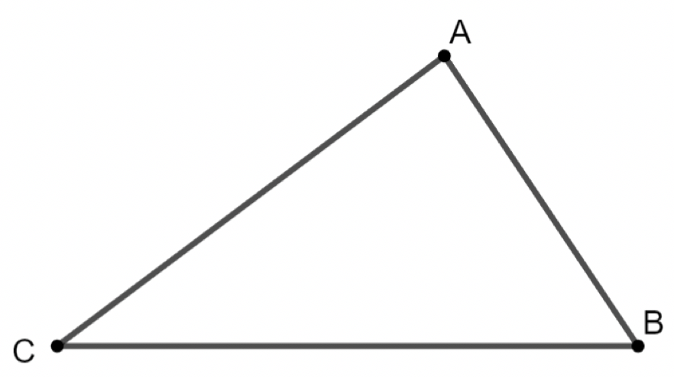
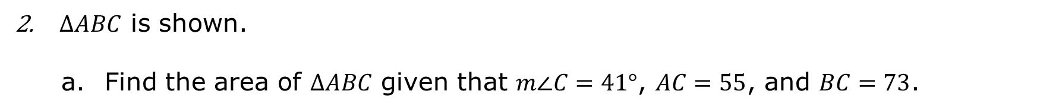
$∆ABC$ is shown.
Find the area of $∆ABC$ given that $m∠C=41°$, $AC=55$, and $BC=73$.
volume 1, pg. 441

Slide 13
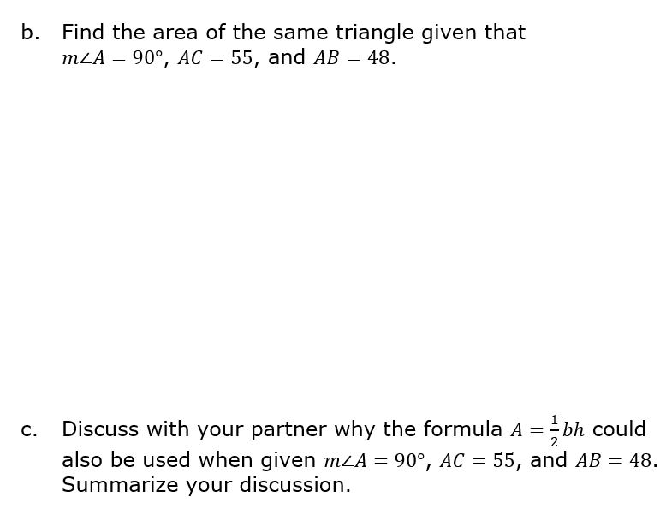
volume 1, pg. 441

Slide 14

Guided Practice
volume 1, pg. 442

Slide 15

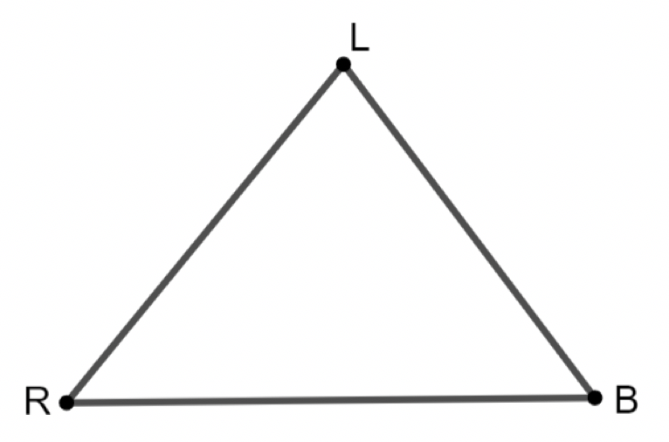

7.H3.3 Guided Practice: Area of a Triangle
$∆RLB$ is shown. $RL=14, RB=16.5,$ and $m∠LRB=50°$. Find the area of the triangle.
In $∆FPB,$ $FP=9$, $PB=18$, and $m∠FPB=117°$. Find the area of the triangle.
volume 1, pg. 442

Slide 16

Your Turn
volume 1, pg. 442

Slide 17
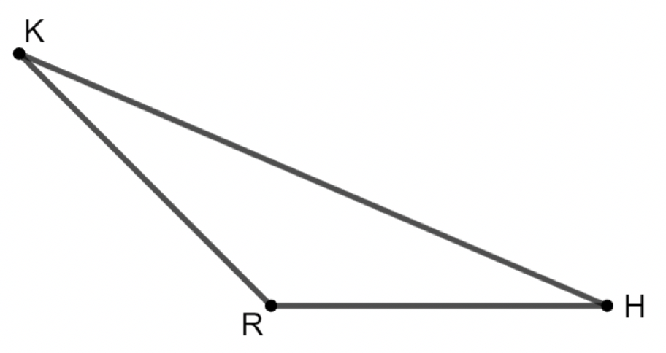
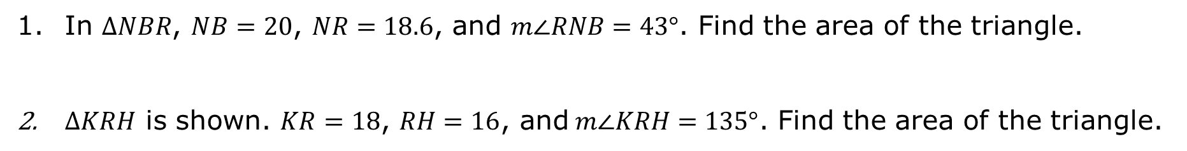
7.H3.4 Your Turn!
In $∆NBR$, $NB=20$, $NR=18.6$, and $m∠RNB=43°$. Find the area of the triangle.
$∆KRH$ is shown. $KR=18$, $RH=16$, and$m∠KRH=135°$. Find the area of the triangle.
volume 1, pg. 442

Slide 18

Wrap-Up
volume 1, pg. 443

Slide 19
7.H3.5 Wrap-Up: Reflection
What are the similarities and differences between finding the area of a triangle and finding the area of a triangle using the sine ratio?
volume 1, pg. 443

